Slide 1
Medicare and Medicaid Updates
Cierra Anderson, MMAP Site Coordinator, Region 1A

Slide 2
What is MMAP?
Michigan Medicare Medicaid Assistance Program
One of 54 State Health Insurance Assistance Programs (SHIP)
Free counseling services
Assistance with Medicare and Medicaid for Medicare beneficiaries
1-800-803-7174

Slide 3
What will be covered?
2020 Medicare cost (Part A & Part B)
2020 Medicaid Eligibility
Medicare Savings Program
Extra Help

Slide 4
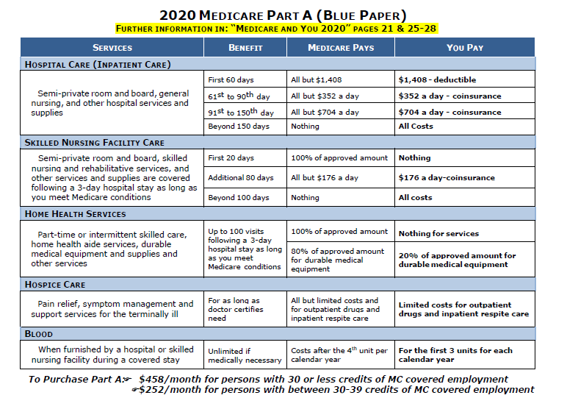

Slide 5
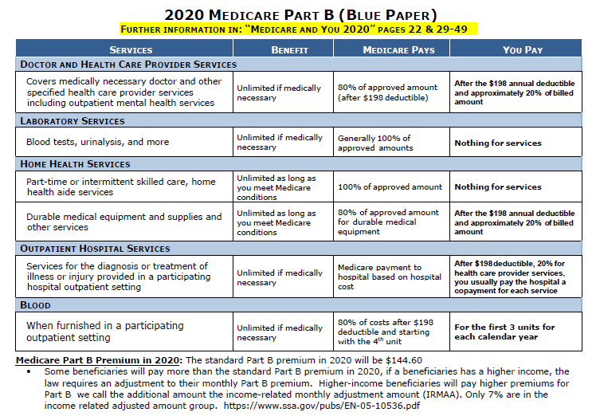

Slide 6
2020 Medicaid Eligibility
Income Limit
$1084 (single individual)
$1457 (married couple)
Asset Limit
$2000 (single individual)
$3000 (married couple)

Slide 7
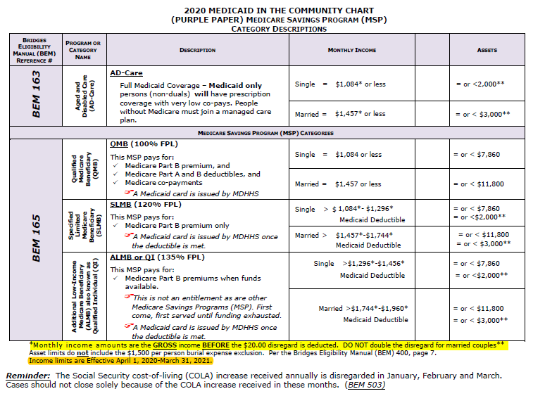

Slide 8
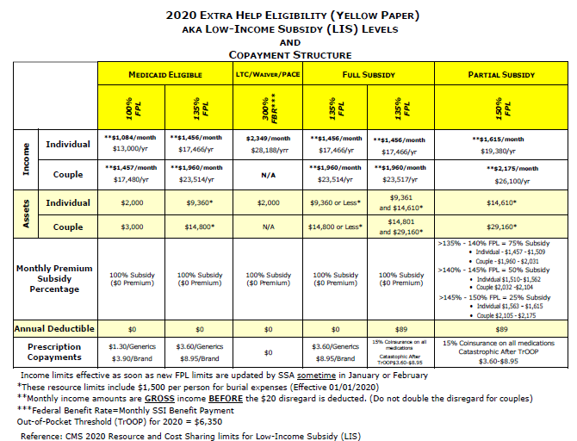

Slide 9
What we covered
2020 Medicare cost (Part A & Part B)
2020 Medicaid Eligibility
Medicare Savings Program
Extra Help

Slide 10
Questions?

