Slide 1
5 Key Benefits

Slide 2
Michigan’s Coordinated Access to Food for the Elderly (MiCAFE)
MiCAFE, a program of Elder Law of Michigan, Inc., helps individuals apply for benefits that meet their basic needs including food, utilities, medical assistance, and prescriptions. Application assistance is available over the phone and is primarily for people age 60 and older.
If you or someone you know is 60 or older and living on a limited income, MiCAFE is here to help! MiCAFE will help you or your loved one apply for benefits you might have earned, but may not know about.

Slide 3
5 Key Benefits
Supplemental Nutrition Assistance Program
(SNAP)
Medicare Savings Program
(MSP)
Medicaid
Medicare Extra Help/Low Income Subsidy (LIS)
State Emergency Relief
(SER)

Slide 4
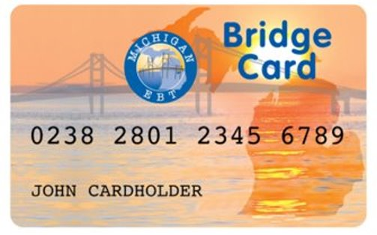
Supplemental Nutrition Assistance Program (SNAP)
Supplemental Nutrition Assistance Program is a federal program that provides nutrition benefits to low-income individuals and families.
SNAP benefits are issued via the Michigan Bridge Card and recipients can use them at participating stores and farmers markets to purchase food.
Over 48% of seniors eligible for SNAP do not apply for or receive the benefit. The purpose of SNAP is to end hunger, improve nutrition, and improve health. Seniors facing hunger have an increased risk of developing health issues like heart attack and congestive heart failure.

Slide 5
SNAP Eligibility
Traditional Eligibility:
Gross Monthly income - Household gross monthly income must be at or below 130 percent of poverty line (FPL) or if Senior/Disabled/Disabled Veteran use 200% FPL
Net Income - Household net monthly income must be at or below 100 percent of poverty line after deductions are applied.
Asset limit - $15,000
Citizenship - Only U.S. citizens and certain lawfully-present non-citizens may receive SNAP benefits.

Slide 6
SNAP Eligibility Overview
Assets
Household
Gross Income either 130% or 200 % of FPL
15,000
live together and purchases and prepares meals together
Expenses
Income
Allowable deductions
Net income of 100 % FPL
Citizenship
Citizenship or certain eligible status

Slide 7
Medicaid
Medicaid is a low-income healthcare program that is funded by the state and federal government and run by the state.
Available to low-income persons aged 65 or older; blind or permanently disabled persons; members of families with dependent children; children in foster care homes; pregnant women; and individuals under age 21 in psychiatric hospitals.

Slide 8
Medicaid Eligibility
Assets
Applicant
$1,414
2,000
Single
Low-Income
(133% FPL)
Citizenship
Michigan and U.S. citizenship or certain eligible status
Married (both)
Married (one)
3,000
3,000
$1,911
$1,911
Very Low-Income
(100% FPL)
$1,063
$1,437
$1,437

Slide 9
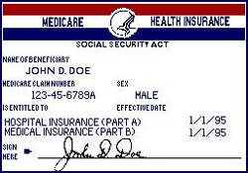
Medicare and Medicare Savings Program
Medicare is federal health insurance program available, regardless of income, medical history, or health status, to persons who are 65 or older, certain younger people with disabilities and people diagnosed with end-stage renal disease (ESRD) and amyotrophic lateral sclerosis (ALS)
Medicare consists of:
Medicare Part A (Hospital Insurance)
Premium-Free Part A: Eligible for Social Security Retirement and paid payroll taxes for 10 or more years
Premium for Part A: Either $458 a month or $252 depending on work history/payroll taxes.
Medicare Part B (Medical Insurance)
Part B premium amount in 2020 is $144.60 (unless eligible for the Medicare Savings Program, which we will cover soon)
Medicare Part D (prescription drug coverage)
Government contracts with private companies and therefore the Part D monthly premium varies by plan (unless eligible for the Medicare Extra help/Low-income subsidy, which we will cover soon)

Slide 10
Medicare Savings Program
Medicare Savings Programs (MSP) are federally funded programs administered by each individual state. MSP may help pay some or all the
Medicare premiums, deductibles, copayments and coinsurance.
Qualifications for MSP is based on income and asset (resources) limits.
Assets –SSI related Medicaid
Applicant
7,860
Individual
Citizenship
Michigan and U.S. citizenship or certain eligible status
Couple
11,800
Assets – all other Medicaid
$2,000
$3,000
Very Low-Income
(100% FPL)
$1,084
$1,457
Full coverage
Low-Income
(100-120% FPL)
$1,084.01-1,296
$1,457.01-1,744
Part B paid

Slide 11
Medicare Extra Help
Medicare Extra Help can help individuals with limited resources and income “get Extra Help with the costs — monthly premiums, annual deductibles, and prescription co-payments — related to a Medicare prescription drug plan. Social Security/Medicare decides if you qualify for the program known as “Extra Help” that helps with drug costs.
Qualifications for Medicare Extra Help/Low Income Subsidy is based on income and asset (resources) limits.
Assets
Applicant
Individual
Couple
$26,160
Income
(135-150% FPL)
$1,595
$2,155
$13,110

Slide 12
State Emergency Relief Program (SER)
The State Emergency Relief Program (SER) provides financial assistance/money quickly for emergencies such as to prevent an eviction, stop a utility shut off, or pay for a burial.
SER eligibility is based on the household composition, monthly income and countable assets.
Assets
Applicant
Individual
Couple
Income –LIHEAP/Energy
(150% FPL)
$1,595
$2,155
$15,000

Slide 13
Michigan’s Coordinated Access to Food for the Elderly (MiCAFE)
If you or someone you know is 60 or older and living on a limited income, MiCAFE is here to help! MiCAFE will help you or your loved one apply for benefits.
MiCAFE Call Center Support
Open 9:00 am – 3:00 pm
Monday – Friday
1-877-664-2233

Slide 14
Darling Garcia, J.D., L.L.M.
MiCAFE Director
Director of Community Services

