Slide 1
Leveraging Narrative/ Community Voice
Amplify

Slide 3
Introduction
Leveraging narrative and community voice in Detroit
or any location is essential
for addressing historical challenges,
promoting equity, fostering trust, and driving innovation.
Community-led solutions
reflect the unique identity and needs
of the city and its residents.
Harnessing the Power of Stories for Inclusive Decision-Making
cargo poem reminds me that we need each other and are all valuable and gifts to each other

Slide 4
Historical Context/Cultural Identity
Community-Led Revitalization
Racial and Economic Equity
Innovative Solutions
Trust-Building
Accountability

Slide 5
Examples of Leveraging Narrative/Community Voice Outcomes
Charles H. Wright Museum of African American History
Motown Museum
Detroit Institute of Art
Belle Isle

Slide 7
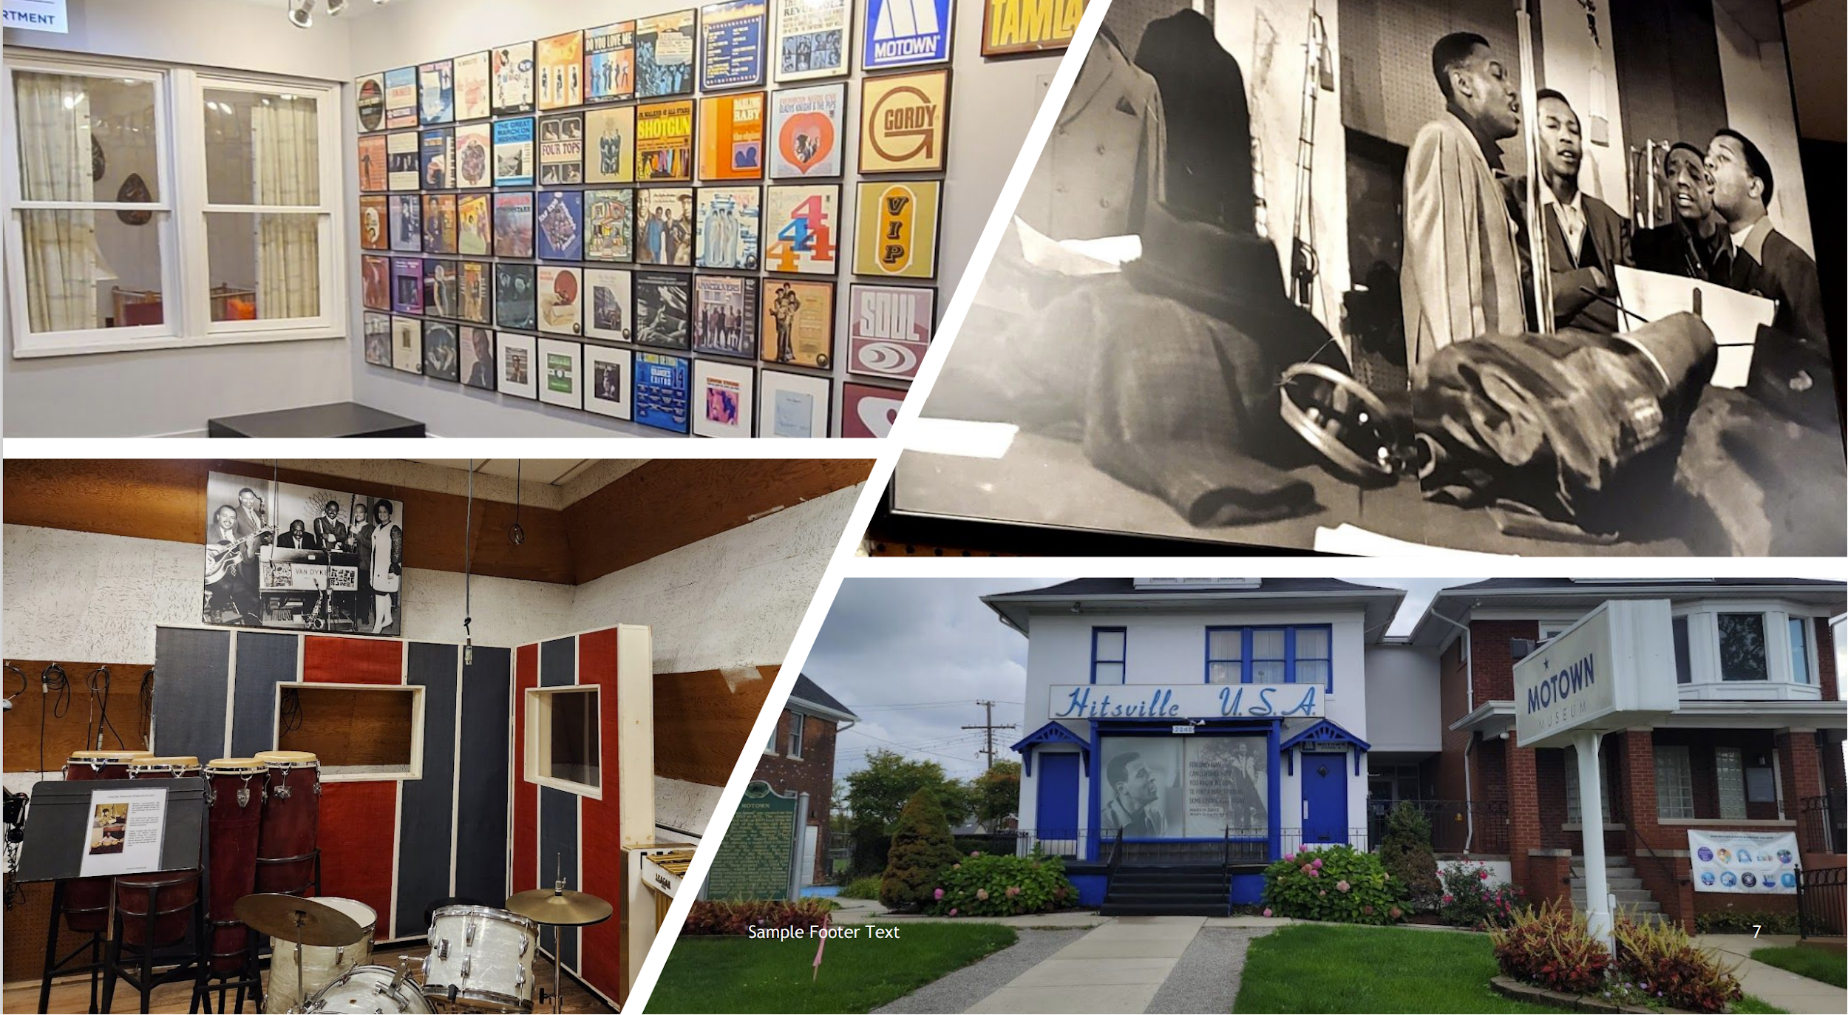

Slide 9
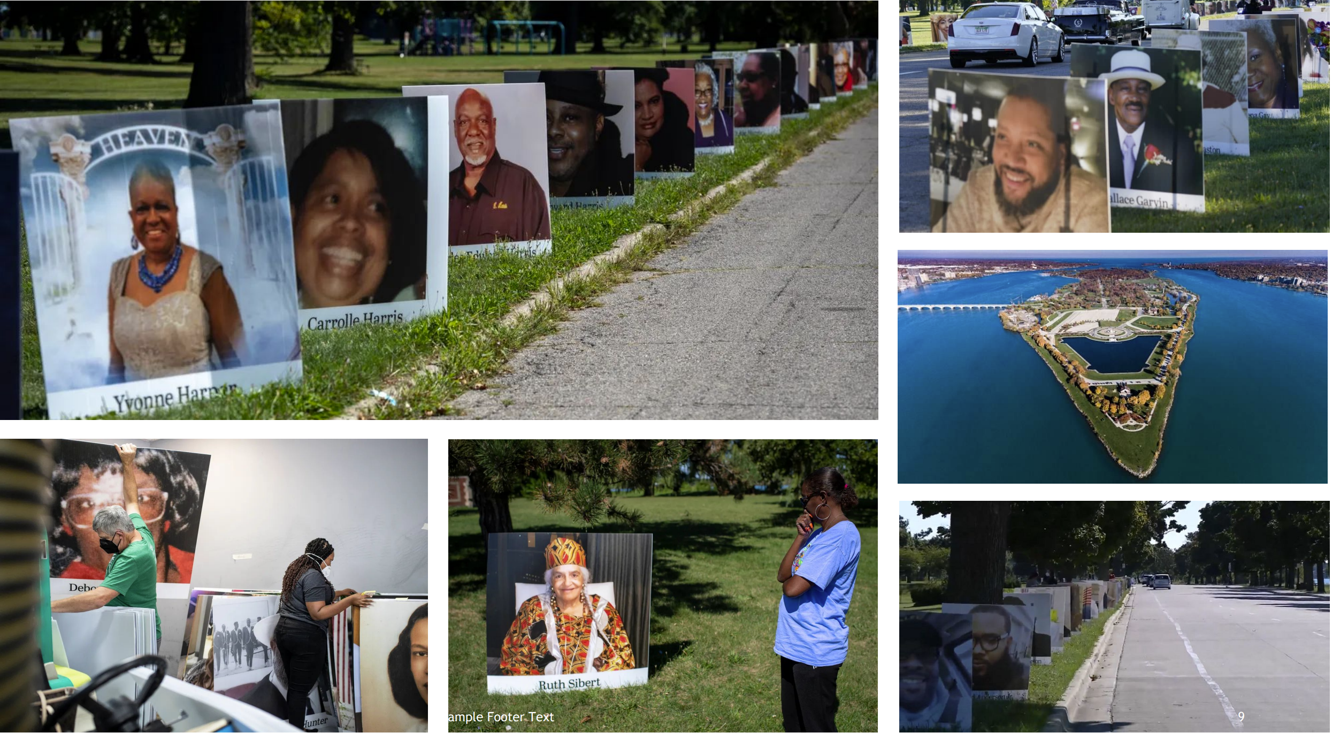

Slide 11
Key points WHY it is crucial to
leverage narrative and
community voice
Empowerment
Inclusivity
Sustainable Solutions
Authenticity
Reducing Disparities
Social Cohesion
Realizing Collective Goals

Slide 12
10 Steps you should know before you attempt to leverage narrative and community voice: it’s essential to take some foundational steps to ensure that the process is inclusive, respectful, and effective.
Educate yourself
Build Relationships
Identify Key Stakeholders
Set Clear Objectives
Provide Support and Resources
Select Appropriate Methods
Establish Trust and Confidentiality
Foster and Inclusive Environment
Cultural Sensitivity
Document and Preserve Narrative Ethically
Notes:
Educate yourself: Gain a deep understanding of the community you’re working with, including its history, culture, and specific needs. This knowledge will help you approach the process with sensitivity and respect.
Build Relationships: Establish trust and rapport with members of the community. Actively listen, show genuine interest, and be open to learning from their experiences.
Identify Key Stakeholders: Determine who the stakeholders are within the community. These could be individuals, organizations, or groups that hold influence and can help facilitate the process of gathering narratives.
Set Clear Objectives: Define the goal and objectives of leveraging narrative and community voice. What do you hope to achieve? This clarity will guide your approach and help measure the impact.
Provide Support and Resources: Offer any necessary support, such as translation services, accessibility accommodations, or resources that may required for full participation.
Select Appropriate Methods: Choose the most suitable methods for gathering community narratives. This could include surveys, focus groups, interviews, workshops, or other participatory approaches.
Establish Trust and Confidentiality: Ensure that community members feel safe and confident in sharing their stories. Communicate how their narratives will be used and protected.
Foster and Inclusive Environment: Create spaces and opportunities for all voices to be heard, especially those from marginalized or underrepresented groups. Ensure that everyone feels valued and respected.
Cultural Sensitivity: Be aware of the cultural nuances and potential sensitivities. Respect cultural traditions and practices when engaging with the community.
Document and Preserve Narrative Ethically: Obtain informed consent from individuals before recording or documenting their narratives. Respect privacy and confidentiality, and follow ethical guidelines for storytelling.

Slide 13
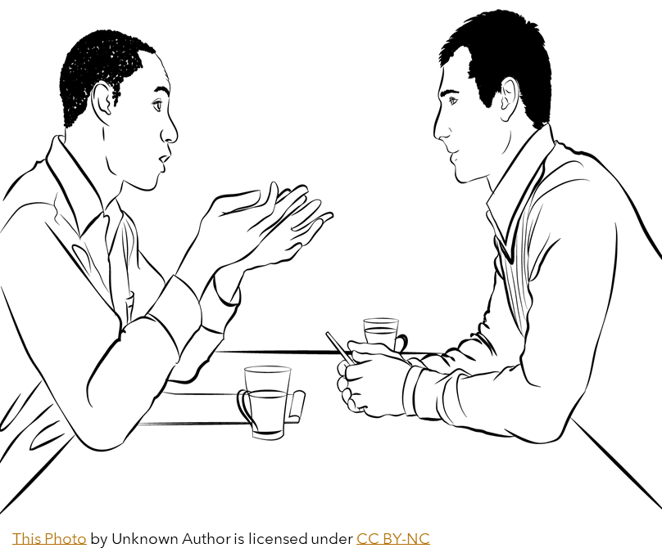
When engaging in conversation about racism, it’s essential to approach the topic with sensitivity, empathy, and respect.

Slide 14
Break-out
These questions are designed to stimulate discussion, encourage reflection, and generate actionable insights from your group. Join one break-out group. Select one person to keep notes and another person to report out. You have 10 minutes. Followed by a one-minute report out.
Group 1
Can you share an example from your experience where community input significantly impacted a project or decision? What were the outcomes?
Group 2
How can you ensure you effectively capture and incorporate diverse narratives within your project or initiatives?
Group 3
What potential challenges or barriers might you face when trying to center community voice? How can you overcome them?
Group 4
What strategies can you employ to ensure that the community voice continues to be heard throughout the lifecycle of a project, from planning to implementation and evaluation?

Slide 15
WIN-WIN-WIN
What does this mean to you?

Slide 16
Questions
QUESTIONS

Slide 17
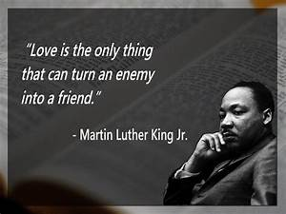
Thank you
Velisa L. Perry
Executive Director
United Health Organization
Facilitator of the
Wayne County Oral Health Coalition
vlp101@aol.com

