Slide 1
Food for Thought:
How to Access Food Programs and Benefits

Slide 2
Who We Are – Elder Law of Michigan
Our Mission
Our Vision
Our Target Populations
Effective solutions that improve quality of life involving Economic Security, Legal Resolutions, and Much-needed Peace of Mind.
Our services address the needs of many different people, but we continue to target our services to older adults and persons with disabilities.
To advocate for, educate, and assist our target populations.

Slide 3
Programs of Elder Law of Michigan

Slide 4
Direct Client Services
Legal Services
Benefits Access
SNAP Benefits Education
Pension Counseling
Application Assistance
Pooled Account Trust

Slide 5
Michigan’s Coordinated Access to Food for the Elderly (MiCAFE)
MiCAFE, a program of Elder Law of Michigan, Inc., helps individuals apply for benefits that meet their basic needs including food, utilities, medical assistance, and prescriptions. Application assistance is available over the phone and is primarily for people age 60 and older.

Slide 6
Food Assistance Benefit Programs Landscape
Access to Food Programs in Michigan
What Is SNAP and Why It’s Important
Relationship to Other Public Benefits
Other Food Assistance Programs
MiCAFE Network Partnership, MDHHS Navigation Partner and Food Benefits
Resources

Slide 7
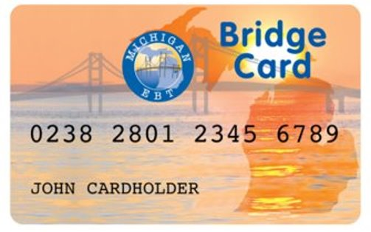
What is SNAP and Why it is Important
Supplemental Nutrition Assistance Program (SNAP) is a federal program that provides nutrition benefits to low-income individuals and families.
SNAP benefits are issued via the Michigan Bridge Card and recipients can use them at participating stores and farmers markets to purchase food.

Slide 8
Stats and Facts
Over 48% of seniors eligible for SNAP do not apply for or receive the benefit.
Common barriers for seniors include transportation, personal attitude, geography, misinformation and mistrust.
Seniors facing hunger have an increased risk of developing health issues like heart attack and congestive heart failure.

Slide 9
SNAP Eligibility
Traditional Eligibility:
Gross Monthly income - Household gross monthly income must be at or below 130 percent of federal poverty level (FPL) or if Senior/Disabled/Disabled Veteran use 200% FPL
Net Income - Household net monthly income must be at or below 100 percent of federal poverty line after deductions are applied.
Asset limit - $15,000
Citizenship - Only U.S. citizens and certain lawfully-present non-citizens may receive SNAP benefits.

Slide 10
SNAP Eligibility – SDV group composition
130 FPL vs. 200 FPL
Households with elderly, disabled or veteran members have different income eligibility rules than other households
130% ($1,396) vs. 200% of FPL ($2,148)
Who is considered elderly?
Those age 60 years or older
Who is disabled?
Generally, those who receive Supplemental Security Income (SSI) or Social Security Disability Insurance (SSDI) benefits

Slide 11
SNAP Eligibility – Categorically Eligible
Some applicants are “Categorically Eligible” for SNAP.
Eligible for means tested program such as
Supplemental Security Income (SSI)
Temporary Assistance for Needy Families (TANF)
Need to complete a SNAP application.

Slide 12
SNAP Eligibility Overview
Household
live together and purchases and prepares meals together
Assets
15,000
Income
Gross Income either 130% ($1,396) or 200% of FPL ($2,148)
Net income of 100 % FPL ($1,074)
Expenses
Allowable deductions
Standard Medical Deduction
Citizenship
Citizenship or certain eligible status

Slide 13
Eligibility - SNAP Household
SNAP Household ?
Generally, everyone who live together and purchases and prepares meals together is considered a household for SNAP
Exceptions :
60+ and are unable to purchase and prepare meals separately

Slide 14
Eligibility - SNAP Household - continued
Household
Who applies for food assistance together?
If a senior lives with:
They should apply:
Spouse
together
An adult child who is not disabled and does not purchase and prepare meals together.
separately
Grandchildren under age 22 which they are primary caregiver
together

Slide 15
Eligibility - Assets
Bank/Credit Union Accounts
Trust/Annuity
Stocks/Bonds
Life Insurance
Property
Burial Plot/Funeral Contract
Retirement: IRA/401k
Vehicles
$15,000 limit increased on 12/1/19 ($5,000)

Slide 16
Eligibility - Income
What are the income limits?
Income
Gross Income vs. Net Income
Income Test:
SDV group composition can use the 200 % FPL for gross income, but their net income must be below 100% FPL and meet the asset limit.
200% of FPL ($2,148)
Net income of 100 % FPL ($1,074)
Gross vs. Net Income
Gross income is all income received before payroll taxes and other allowed deductions.
Net income is all income received after deductions.

Slide 17
Eligibility - Gross Income
Gross Income
What type of income?
Income 200% FPL
Social Security/Supplemental Security Income (RSDI/SSI)
Sick Benefits/Worker’s Compensation/Disability Benefits
Veterans/ Military Benefits
Pension/Retirement Benefits
Income from renters, roomers and/or boarders
Employment income (*earned income*)
Income from tribal casino profit sharing
All other income

Slide 18
Eligibility - Gross Income Review
Who can use 200% FPL for gross income?
SDV Households
What are the types of Income?
unearned income
Supplemental Security Income (SSI) and veterans, disability, and death benefits
Income from tribal casino profit sharing
All other income
What is earned income?
Employment income (*earned income*)

Slide 19
Eligibility: Gross Income – Deductions = Net income
Income
Allowable Deductions?
Allowable Deductions
A 20-percent deduction from earned income*.
A standard deduction
A dependent care deduction.
Medical expenses for elderly or disabled members that are more than $35 for the month.
Court order child support payments.
Standard shelter deduction for homeless households.
Excess shelter costs.

Slide 20
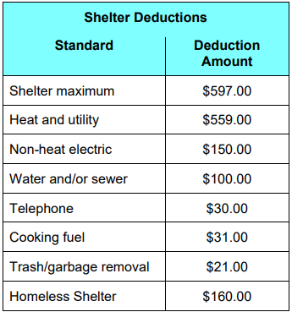
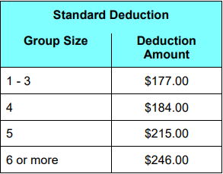
Eligibility: Gross Income – Deductions = Net income
Net Income Calculation steps:
Start with Gross income
Less the 20% deduction from earned income*
Less standard deduction
Less dependent care deduction
Less Court order child support payments
Less Standard Medical expenses for elderly or disabled members.
Less Standard shelter deduction for homeless households
Less Excess shelter costs
Allowable deductions:
A 20-percent deduction from earned income*.
A standard deduction of $____
A dependent care deduction.
Court order child support payments.
Medical expenses for elderly or disabled members that are more than $35 for the month.
Standard shelter deduction for homeless households.
Excess shelter costs.
MDHHS Allowable Deductions:

Slide 21
Eligibility - Income Example
Interactive example
No wrong answers
Give it a try!

Slide 22
Eligibility - Income Example
Net Income Example
Ms. Smith lives alone and her only income is Social Security $1,100/mo in gross income (before her Medicare Premium is deducted).
She pays $170.10/mo for Medicare.
On average she pays $40/mo for Dr. visits.
She pays $630/mo in rent and her heat and other utilities are included in rent.

Slide 23
Eligibility - Income Example
Gross Income
Social Security $1,100
Net Income Calculation steps:
Gross Income $ 1,100
Less the 20% EI? $ 0
Less SD $ 177
Less DCD $ 0
Less COCSP $ 0
Less MP $ 200*
Less SDS $ 597
Less ESC
Total $ 126*
*SNAP Benefit determined
Expenses/Deductions
Medicare Prem $170.10 Dr. Visits $ 40.00 Rent $630.00
Standard Deductions
Standard Deduction $177.00
Standard Shelter $ 597.00 Standard Medical $200.00

Slide 24
SNAP Application Process

Slide 25
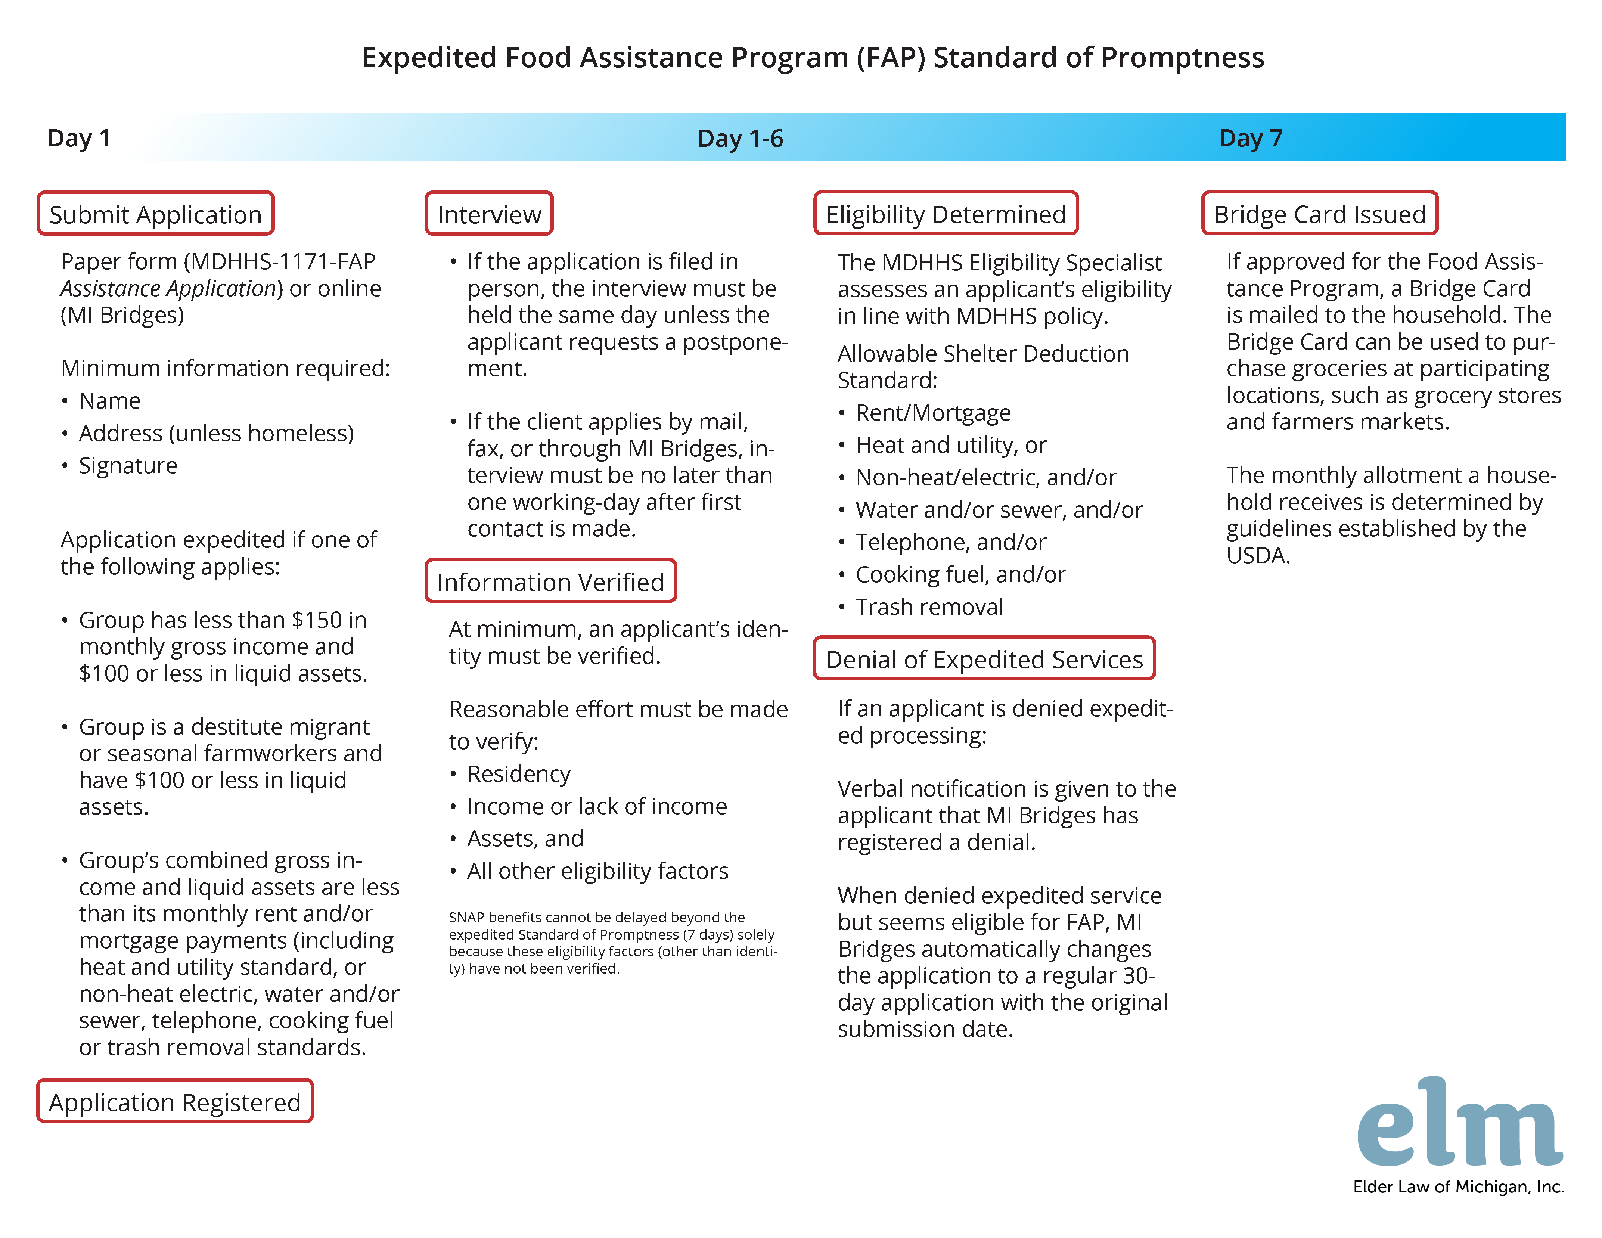
SNAP Application Process

Slide 26
What Can Clients Purchase with SNAP?
What SNAP can buy?
breads and cereals, fruits and vegetables, meats, fish and poultry, dairy products, and seeds and plants which produce food for the household to eat
SNAP is not allowed to be used for:
Beer, wine, liquor, cigarettes or tobacco;
any nonfood items, such as pet food, soaps, paper products, and household supplies; vitamins and medicines;
food that will be eaten in the store; and hot food
SNAP to be used by qualifying homeless people, the elderly, and disabled to purchase low-cost meals from qualifying restaurants.
SNAP can not be exchanged for cash

Slide 27
SNAP and Relationship to Other Public Benefits
MiCAP
SSA applicants for Supplemental Security Income (SSI) are informed about SNAP, and SSI applicants may start a SNAP application at the same time they apply for SSI or when they recertify their SSI eligibility.
SSA forwards the SNAP application to the state SNAP eligibility office, and they processes the SNAP application.
MiCAP is designed to simplify SNAP enrollment for SSI recipients using data from SSI application.

Slide 28
SNAP and Other Food Assistance Programs
Commodity Supplemental Food Program (CSFP)
Works to improve health of low-income seniors by providing them with nutritious food
Eligibility: Age 60+ with income less than 130% FPL
State agencies (departments of health, human services) store CSFP food, and distribute through local agencies
Available in 49 states (all except AL), DC, Puerto Rico, and 3 reservations/Indian Nations
Get the CSFP fact sheet at: http://www.fns.usda.gov/csfp

Slide 29
SNAP and Other Food Assistance Programs
Senior Farmer’s Market Nutrition Program (SFMNP)
An anti-hunger program that gets food quickly to people in need. Grants are issued to states, D.C., U.S. territories, and Tribal governments to:
Help low-income seniors purchase eligible food at farmers’ markets, roadside stands, and community supported agriculture programs
Eligibility: Age 60+ with income less than 185% FPL
More info at: http://www.fns.usda.gov/sfmnp

Slide 30
SNAP and Other Food Assistance Programs
The Emergency Food Assistance Program (TEFAP)
An emergency food distribution program, USDA provides food items to states distribution formula based on the number of unemployed people, and the number of people living below the poverty level
States then provide the food to local agencies, usually food banks, which distribute it to local organizations (i.e. soup kitchens or food pantries) to serve eligible beneficiaries
Those who get TEFAP services can also qualify for SNAP
More info at: http://www.fns.usda.gov/tefap

Slide 31
Double Up Food Bucks
In Michigan, Fair Food Network’s Double Up Food Bucks program provides healthy incentives for SNAP recipients who use their Bridge Card at participating farmers markets and grocery stores.
http://www.doubleupfoodbucks.org/

Slide 32
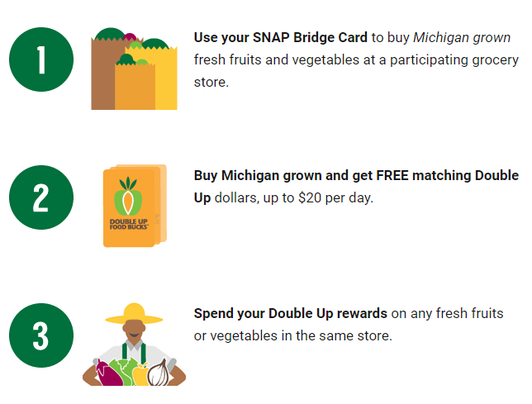

Slide 33
MiCAFE Network Partnership, MDHHS Navigation Partner and Food Benefits
Network Specialists
Network Partners
Application Assistants
MiCAFE Network
MDHHS
The MiCAFE Network is made up of Community Partners who help members of the community access SNAP and other benefits.

Slide 34
MiCAFE provides:
Outreach Collaboration
Training and Education
Access to Network Partners Resources
Data Reporting
One-on-One Application Assistance
Site Reimbursements*
An extensive Partner Network Throughout Michigan
Tech Support from Network Specialists
Annual Client Follow Up at Recertification

Slide 36
MiCAFE Network Partnership, MDHHS Navigation Partner and Food Benefits

Slide 37
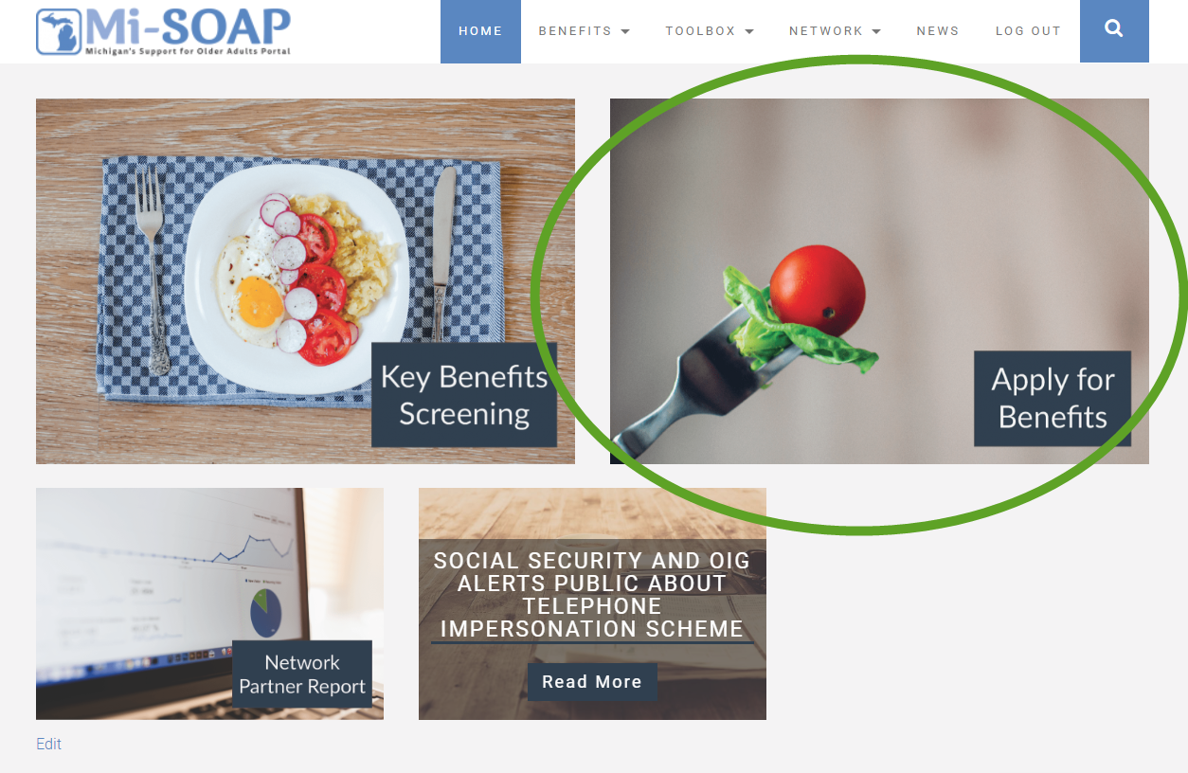
MDHHS Navigation Partner and Food Benefits
Online application on MI Bridges through MiSOAP.org

Slide 38
What is MI Bridges?
MDHHS Navigation Partner and Food Benefits
A secure internet portal offering access to MDHHS benefit applications anytime, anywhere.
Developed and maintained by the Michigan Department of Health and Human Services.
Allows households to create an account to apply for benefits, check case status, and recertify online.

Slide 39
What is a Navigation Partner?
MDHHS Navigation Partner and Food Benefits
Agree to providing technical assistance and one-on-one navigation assistance.
Directly help individuals who may be unable to use the system enter data for the application.
Successfully completes the MI Bridges Navigation Training
Participate in trainings and/or webinars for updates

Slide 40
MDHHS Navigation Partner and Food Benefits
Navigation partner account must be created in MI Bridges
A navigation partner can decide to be part of an existing organization or
New organization
MIBRIDGES training must be passed, and navigation partner is assigned a CPID
Navigation partner Dashboard
Client directory
Client case information
Resources

Slide 41
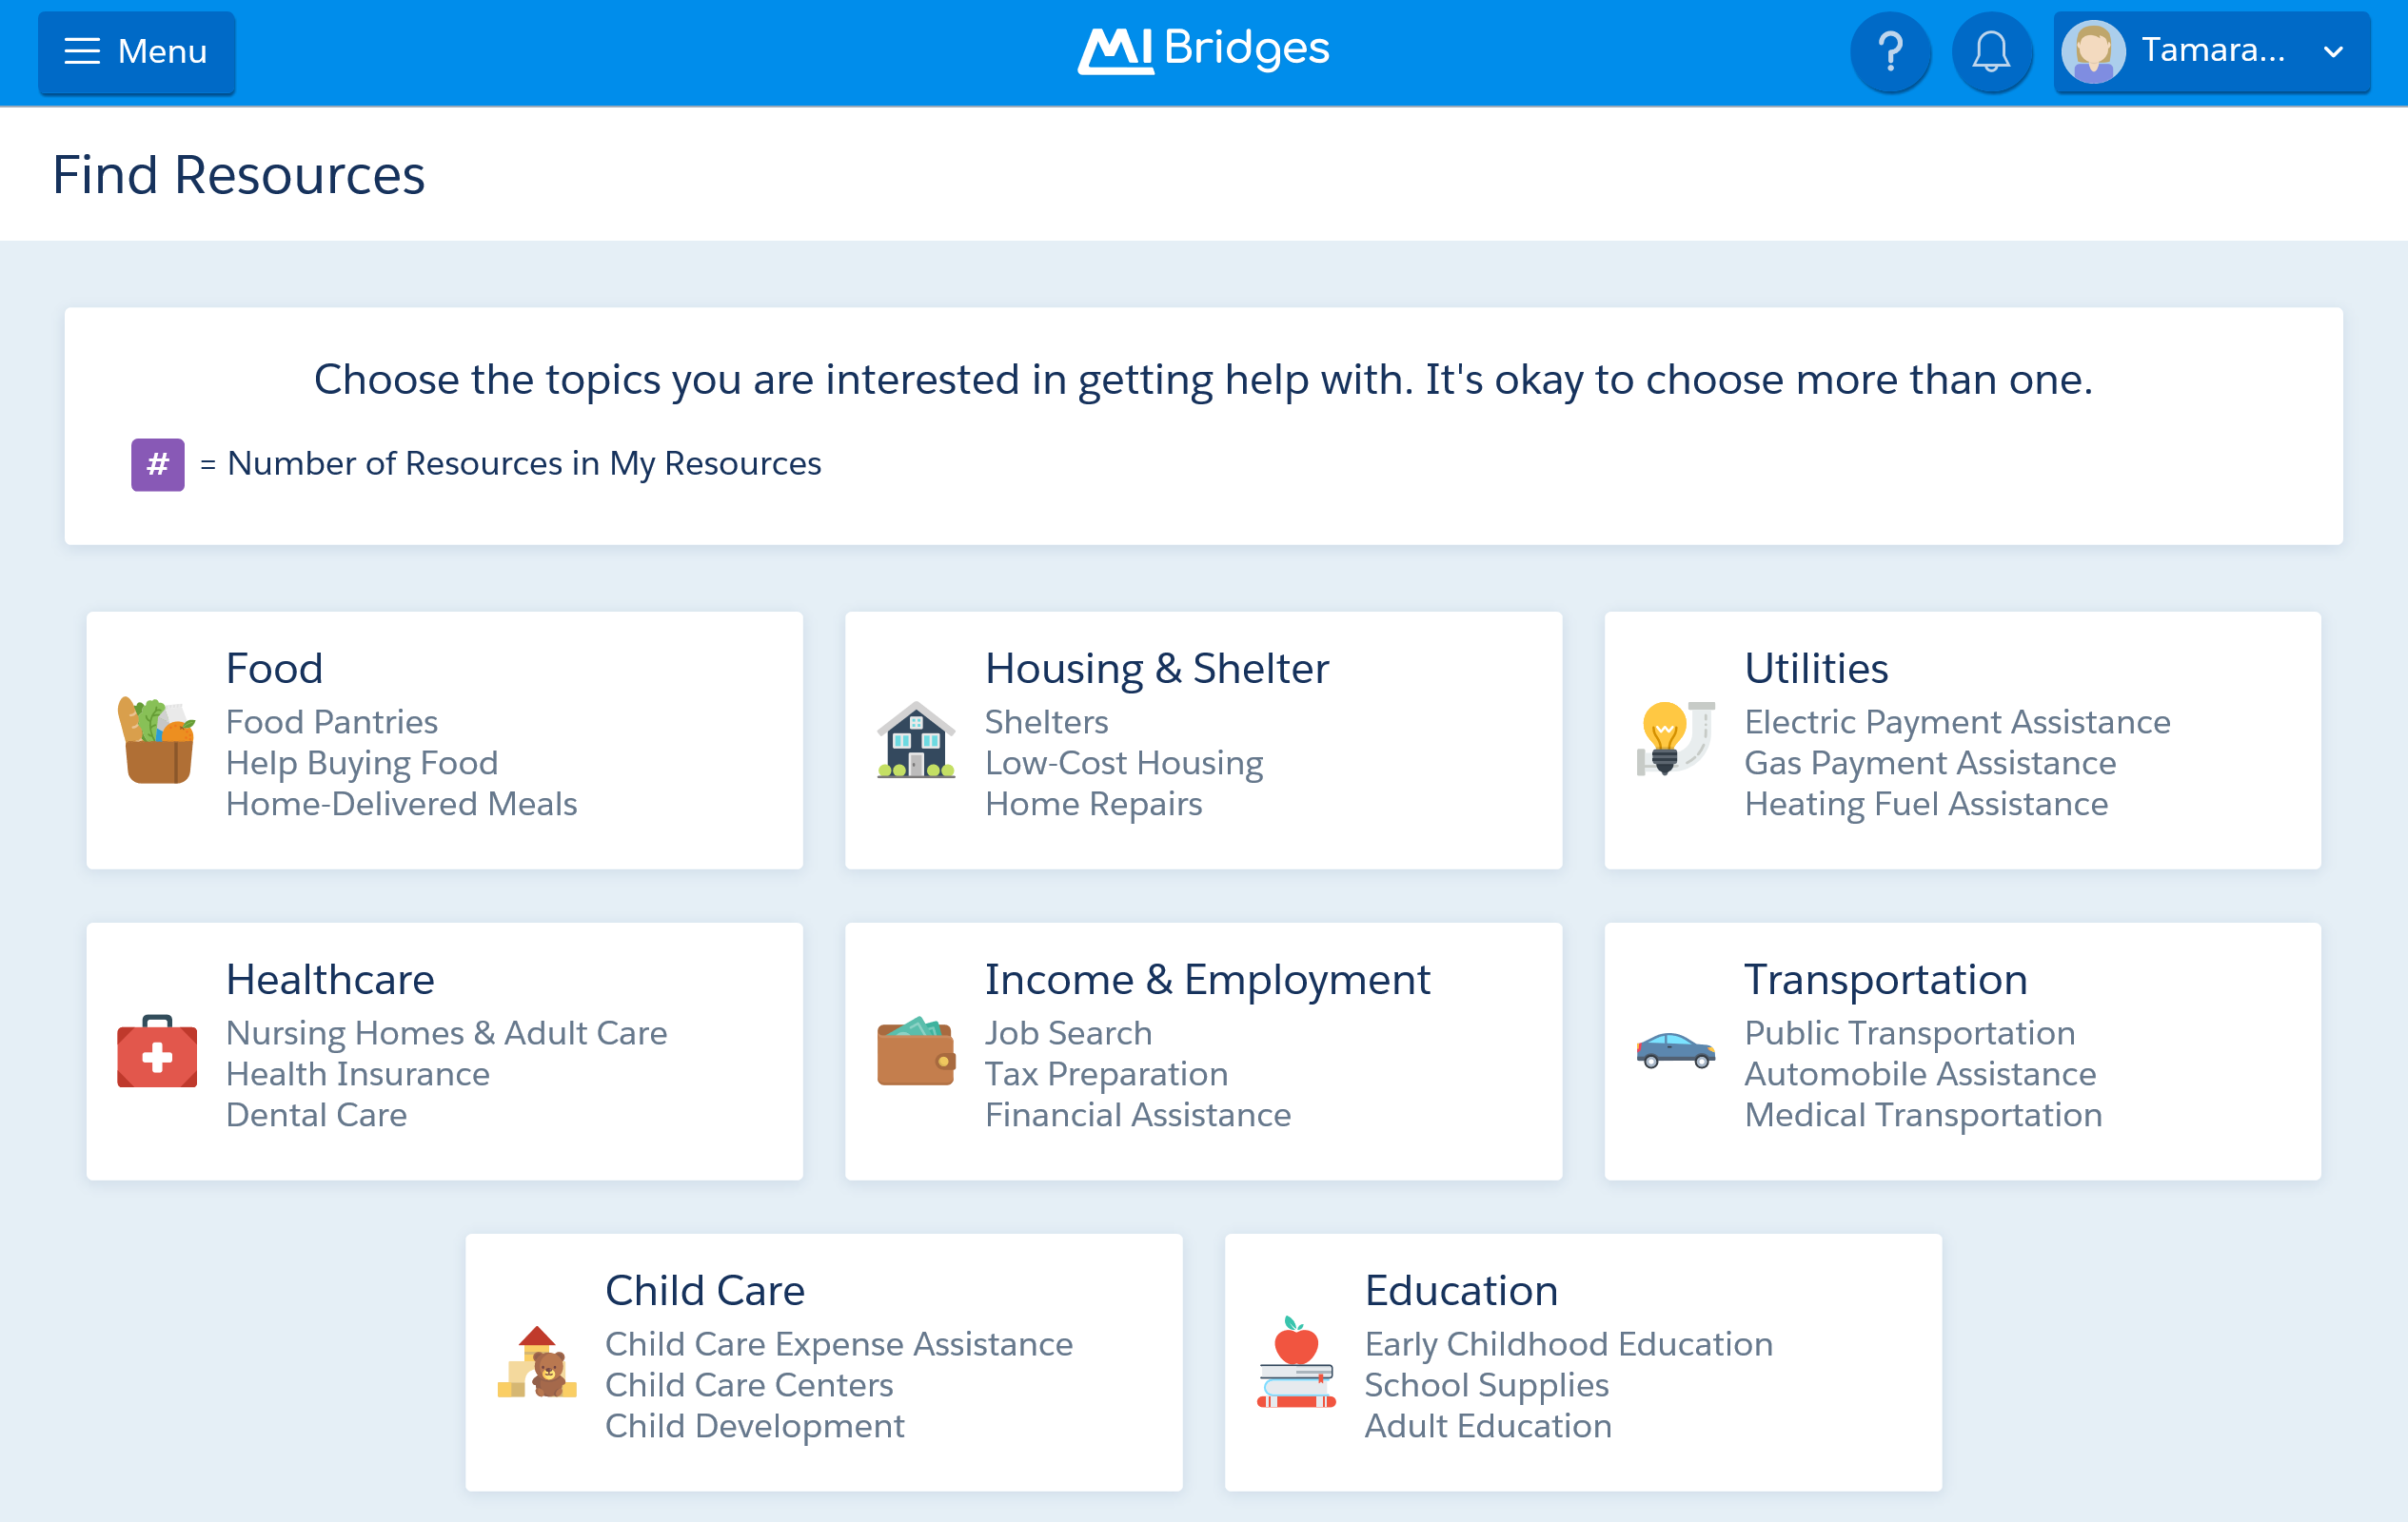
MDHHS Navigation Partner and Food Benefits

Slide 42
MDHHS Navigation Partner and other Benefits
What types of benefits can you apply at MI Bridges?
Food Assistance Program (FAP)
State Emergency Relief (SER)
Medical Assistance (MA)
Child Development Care (CDC)
Family Independence Program (FIP)

Slide 43
MDHHS Navigation Partner and Other Benefits
Medicaid
Medicare Savings Program
(MSP)
Medicare Extra Help/Low Income Subsidy (LIS)
State Emergency Relief
(SER)

Slide 44
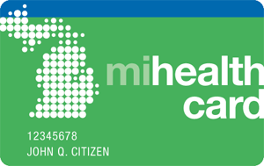
Medicaid
Medicaid is a low-income healthcare program that is funded by the state and federal government and run by the state.
Available to low-income persons aged 65 or older; blind or permanently disabled persons; members of families with dependent children; children in foster care homes; pregnant women; and individuals under age 21 in psychiatric hospitals.

Slide 45
Medicaid Eligibility
Applicant
Single
Married (both)
Married (one)
Assets
2,000
3,000
3,000
Very Low-Income(100% FPL)
$1,133
$1,526
$1,526
Low-Income (133% FPL)
$1,506
$2,029
$2,029
Citizenship
Michigan and U.S. citizenship or certain eligible status

Slide 46
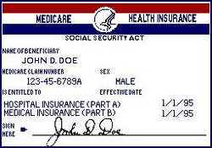
Medicare and Medicare Savings Program
Medicare is federal health insurance program available, regardless of income, medical history, or health status, to persons who are 65 or older, certain younger people with disabilities and people diagnosed with end-stage renal disease (ESRD) and amyotrophic lateral sclerosis (ALS)
Medicare consists of:
Medicare Part A (Hospital Insurance)
Premium-Free Part A: Eligible for Social Security Retirement and paid payroll taxes for 10 or more years
Premium for Part A: Either $499 a month or $274 depending on work history/payroll taxes.
Medicare Part B (Medical Insurance)
Part B premium amount in 2021 is $170.10 (unless eligible for the Medicare Savings Program, which we will cover soon)
Medicare Part D (prescription drug coverage)
Government contracts with private companies and therefore the Part D monthly premium varies by plan (unless eligible for the Medicare Extra help/Low-income subsidy, which we will cover soon)

Slide 47
Medicare Savings Program
Medicare Savings Programs (MSP) are federally funded programs administered by each individual state. MSP may help pay some or all the
Medicare premiums, deductibles, copayments and coinsurance.
Qualifications for MSP is based on income and asset (resources) limits.
Applicant
Individual
Couple
Assets –SSI related Medicaid
8,400
12,960
Assets – all other Medicaid
$2,000
$3,000
Very Low-Income
(100% FPL)
$1,153
$1,546
Full coverage,
Low-Income
(100-120% FPL)
$1,153.01-1,379
$1,546.01-1,851
Part B paid
Citizenship
Michigan and U.S. citizenship or certain eligible status

Slide 48
Medicare Extra Help
Medicare Extra Help can help individuals with limited resources and income “get Extra Help with the costs — monthly premiums, annual deductibles, and prescription co-payments — related to a Medicare prescription drug plan. Social Security/Medicare decides if you qualify for the program known as “Extra Help” that helps with drug costs.
Qualifications for Medicare Extra Help/Low Income Subsidy is based on income and asset (resources) limits.
Applicant
Individual
Couple
Assets
$15,510
$30,950
Income
(135-150% FPL)
$1,719
$2,309

Slide 49
State Emergency Relief Program (SER)
The State Emergency Relief Program (SER) provides financial assistance/money quickly for emergencies such as to prevent an eviction, stop a utility shut off, or pay for a burial.
SER eligibility is based on the household composition, monthly income and countable assets.
Applicant
Individual
Couple
Assets
$15,000
Income –LIHEAP/Energy
(150% FPL)
$1,699
$2,289

Slide 50
Resources
USDA FNS SNAP Program at: www.fns.usda.gov/snap
BenefitsCheckup screening tool for SNAP: www.benefitscheckup.org/getsnap
SNAP outreach materials, best practices handbook, and more from NCOA at: www.ncoa.org/SeniorHunger
Find other Benefits 101 resources at: www.ncoa.org/resources (search for Benefits 101)
www.misoap.org

Slide 51
Michigan’s Coordinated Access to Food for the Elderly (MiCAFE)
If you or someone you know is 60 or older and living on a limited income, MiCAFE is here to help! MiCAFE will help you or your loved one apply for benefits.
MiCAFE Call Center Support
Open 9:00 am – 3:00 pm
Monday – Friday
1-877-664-2233

Slide 52
Darling Garcia
Betsy Smith

